Slide 1

EMT Just In Time Training Modules, COVID-19
Risk Communications & Community Engagement

Slide 2

Session Outcomes
Outline the role of EMT staff in communicating health messages to the COVID-19 affected communities with which they are working, including messaging that encourages health seeking behaviors
Apply skills for effectively communicating with COVID-19 patients and their families appropriate to the clinical context
Integrate relevant health education communication materials into daily operations

Slide 3
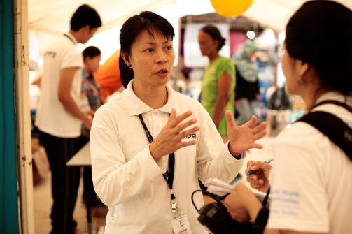
Message Delivery
SUCCESSFUL MESSAGE DELIVERY = BUILDING AND MAINTAINING TRUST
HIGH TRUST=HIGHER ADOPTION OF HEALTH ADVICE
LOW TRUST= LOWER ADOPTION OF HEALTH ADVICE
Notes:
In Stakeholder theory, the highest trust was placed in members of the healthcare profession, some of the lowest trust was in the media, who were perceived to be “hyping’” the pandemic (Henrich and Holmes, 2009, 2011, Hine, 2010, Hilton and Smith, 2010)
In other words
Communities tend to trust EMTs more than any other stakeholder in health related emergencies. But what you say and how you say it will significantly impact whether that trust is maintained.

Slide 4
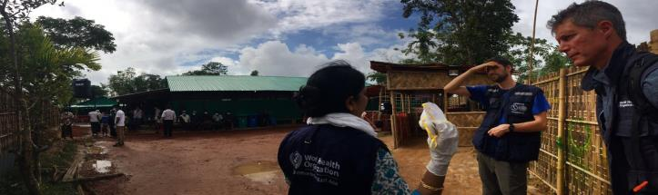
How to Build Trust
Consider factors that influence and/or encourage desired behaviours:
Perceived Risk
Confidence in public health measure or advice
Cultures, norms traditions, beliefs
Notes:
Prati et al. (2011) the social and cultural norms and pressures and their effect on behaviour. This would explain why people sometimes hesitate to take public health actions even if they know they will be effective – for example, in South East Asia, farmers are reluctant to cull their AI infected poultry because of the economic impact.
Additionally, research shows that the individual’s risk perception is highly influenced by their social circle. Particularly, the researchers found that the worry individuals had for their family and friends was the strongest predictor of how highly they would rate a risk.

Slide 5
Group Exercise
Critical
Severe
Mild
Moderate
Mechanical Ventilation
Oxygen Therapy
Isolation

Slide 6
Group Exercise
Identify which point in the right-hand triangle your scenario is in
Provide 3 - 5 key public messages for patients and relatives in the scenario, based on the operational considerations
Identify tools and techniques which might be used to achieve a higher success rate in delivery of these key messages
Severe
Mild
Moderate
Mechanical Ventilation
Oxygen Therapy
Isolation
Critical

Slide 7
Remember: Community Interaction Also Involves Self-Care
What are your tips for personal and team stress management during the COVID response?
Taking control over personal work routines (e.g. shift
allocations, time-outs)
Having healthy daily habits (e.g. sleep, exercise, non-work activities, avoid drug or substance abuse)
Buddy-buddy support system
Finding ways to communicate
Relaxation techniques
Positive re-framing
Easy access to organisational support systems

Slide 8
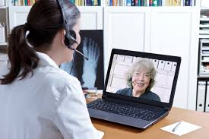
Phone Communications with Relatives
Cognitive aspects
Emotional aspects
Personal aspects

Slide 9
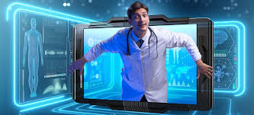
Skills Practice
Call 1: A call from a relative of a patient who is severe but not critical, e.g. receiving oxygen to help breathing
Call 2: A call from a relative of a patient who is critical on a ventilator with no clear indication that he is getting better or worse
Call 3: A call from a relative of a patient who is in critical condition and has a possibility of dying within hours or days

Slide 10
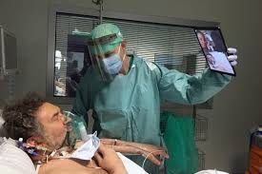
What Family Members Need
Need to feel hope
Need to feel that staff care about the patient
Need to be kept informed about progress

Slide 11
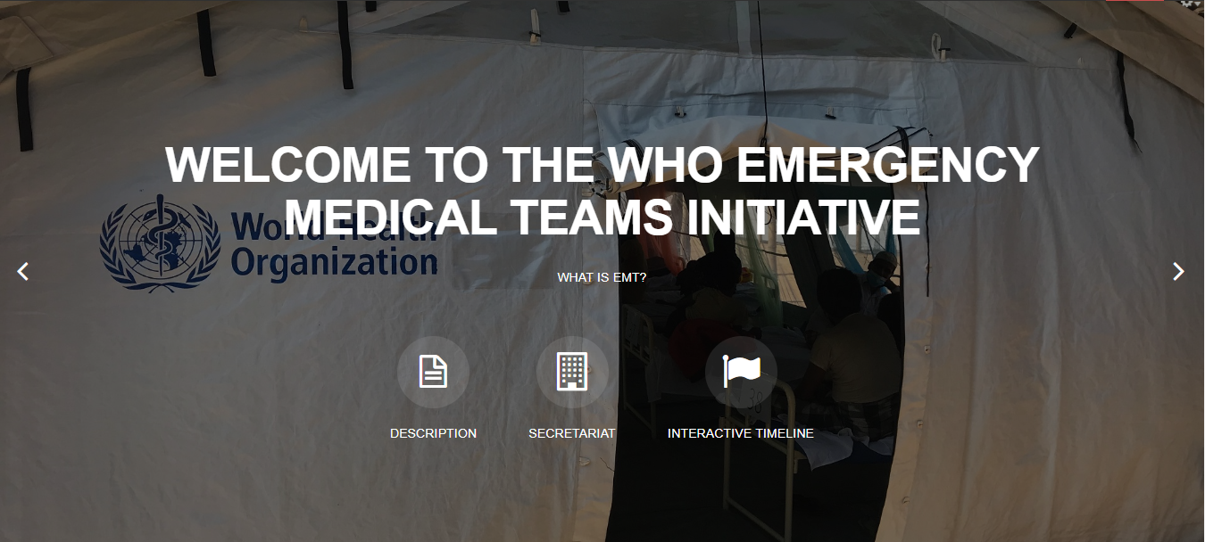
Thank you
Any questions?
For more…
http://extranet.who.int/emt/
EMTeams@who.int

